Slide 1
4. Artificial Neural Networks
18 September 2020, 10-11 AM
Dr. Sireesha Rodda
Professor
Department of Computer Science and Engineering
GITAM Institute of Technology (GIT)
Visakhapatnam – 530045
Email: srodda@gitam.edu

Slide 2
Neural nets can be used to answer the following:
  Pattern recognition: Does that image contain a face?
  Classification problems: Is this cell defective?
  Prediction: Given these symptoms, the patient has disease X
  Forecasting: predicting behavior of stock market
  Handwriting: is character recognized?
  Optimization: Find the shortest path for the TSP.

Slide 3
Roots of work on NNs are in:
Neurobiological studies:
  How do nerves behave when stimulated by different magnitudes of electric current?
  Is there a minimal threshold needed for nerves to be activated?
  How do different nerve cells communicate among each other?
Psychological studies:
  How do animals learn, forget, recognize and perform various types of tasks?
Psycho-physical:experiments help to understand how individual neurons and groups of neurons work.
McCulloch and Pitts introduced the first mathematical model of single neuron, widely applied in subsequent work. ( we’ll look at this)

Slide 4
Biological Neurons
human information processing system consists of brain neuron: basic building block
  cell that communicates information to and from various parts of body
Simplest model of a neuron: considered as a threshold unit –a processing element (PE)
Collects inputs & produces output if the sum of the input exceeds an internal threshold value

Slide 5
Biological neurons
dendrites
cell
axon
synapse
dendrites

Slide 6
Artificial Neural Nets (ANNs)
Many neuron-like PEs units
  Input & output units receive and broadcast signals to the environment, respectively
  Internal units called hidden units since they are not in contact with external environment
  units connected by weighted links (synapses)
A parallel computation system because
  Signals travel independently on weighted channels & units can update their state in parallel
  However, most NNs can be simulated in serial computers

Slide 7
Properties of ANNs
Many neuron-like threshold switching units
Many weighted interconnections among units
Highly parallel, distributed process
Emphasis on tuning weights automatically
Input is a high-dimensional discrete or real-valued (e.g, sensor input)

Slide 8
Properties of ANNs II
Output is discrete or real-valued
Output is a vector of values
Possibly noisy data
Form of target function is unknown

Slide 9
Neuron
node = unit
link
node
node
node
activation
level
weight of link
A NODE
a_{i} = g(in_{i})
a_{j}
W_{j,i}
input
function
activation function
output
in_{i}
g
output
links
input links
a_{i}

Slide 10
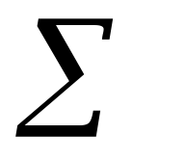
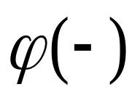

Neuron
Bias
b
x₁
w₁
Activation
function
Local
Field
v
Output
y
Input
values
x₂
w₂
Summing
function
x_{m}
w_{m}
weights

Slide 11
g = Activation functions for units
Step function
(Linear Threshold Unit)
Sign function
Sigmoid function
sign(x) = +1, if x >= 0
-1, if x < 0
sigmoid(x) = 1/(1+e^{-x})
step(x) = 1, if x >= threshold
0, if x < threshold

Slide 12
Network architectures
Three different classes of network architectures
  single-layer feed-forward
  multi-layer feed-forward
  recurrent
The architecture of a neural network is linked with the learning algorithm used to train

Slide 13
Note:
recurrent: links form arbitrary topologies e.g., Hopfield Networks and Boltzmann machines
Recurrent networks: can be unstable, or oscillate, or exhibit chaotic
behavior e.g., given some input values, can take a long time to
compute stable output and learning is made more difficult….
However, can implement more complex agent designs and can model
systems with state
We will focus more on feed- forward networks

Slide 14
Single Layer Feed-forward
Input layer
of
source nodes
Output layer
of
neurons

Slide 15
Multi layer feed-forward
3-4-2 Network
Input
layer
Output
layer
Hidden Layer

Slide 16
Feed-forward networks:
Advantage: lack of cycles = > computation proceeds uniformly
from input units to output units.
-activation from the previous time step plays no part in
computation, as it is not fed back to an earlier unit
- simply computes a function of the input values that depends on
the weight settings –it has no internal state other than the weights
themselves.
- fixed structure and fixed activation function g: thus the functions
representable by a feed-forward network are restricted to have a
certain parameterized structure

Slide 17
Neural Network Learning
Objective of neural network learning: given a set of examples, find parameter settings that minimize the error.
  The aim is to obtain a NN that generalizes well, that is, that behaves correctly on new instances of the learning task.
Programmer specifies
- numbers of units in each layer
- connectivity between units,
Unknowns
- connection weights

Slide 18
Therefore A NN is specified by:
  an architecture: a set of neurons and links connecting neurons. Each link has a weight,
  a neuron model: the information processing unit of the NN,
  a learning algorithm: used for training the NN by modifying the weights in order to solve the particular learning task correctly on the set of training examples.

Slide 19
Learning in Neural Nets
Learning Tasks
Supervised
Unsupervised
  Data:
  Labeled examples
  (input , desired output)
  Tasks:
  classification
  pattern recognition
  regression
  NN models:
  perceptron
  adaline
  feed-forward NN
  radial basis function
  support vector machines
  Data:
  Unlabeled examples
  (different realizations of the
  input)
  Tasks:
  clustering
  content addressable memory
  NN models:
  self-organizing maps (SOM)
  Hopfield networks

Slide 20
Learning Algorithms
Depend on the network architecture:
Error correcting learning (perceptron)
Delta rule (AdaLine, Backprop)
Competitive Learning (Self Organizing Maps)

Slide 21
Perceptron
Rosenblatt (1958) defined a perceptron to be a machine that learns,
using examples, to assign input vectors (samples) to different classes,
using linear functions of the inputs
Minsky and Papert (1969) instead describe perceptron as a stochastic
gradient-descent algorithm that attempts to linearly separate a set
of n-dimensional training data.

Slide 22
Perceptrons
Perceptrons are single-layer feedforward networks
Each output unit is independent of the others
Can assume a single output unit
Activation of the output unit is calculated by:
O = Step₀( W_{j} x_{j} )
  where x_{j} is the activation of input unit j, and we assume an additional weight and input to represent the threshold
j

Slide 23

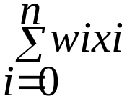
Perceptron
x1
X0 = 1
w1
x2
w0
w2
.
.
xn
wn
1 if
> 0
O =
-1 otherwise
Figure 4.2 (from Mitchell) A perceptron

Slide 24
Linear Separable
x2
x2
+
+
-
-
+
+
x1
x1
-
-
+
-
(a)
(b)
Figure 4.3 (Mitchell)
some functions not representable
- e.g., (b) not linearly separable

Slide 25
How can perceptrons be designed?
The Perceptron Learning Theorem (Rosenblatt, 1960): Given enough training examples, there is an algorithm that will learn any linearly separable function.

Slide 26
Theorem 1 (Minsky and Papert, 1969) The perceptron rule
converges to weights that correctly classify all training examples
provided the given data set represents a function that is linearly
separable

Slide 27
Learning in Perceptrons
Algorithm:
1.randomly assign weights to initial network (usually values range[-0.5,0.5])
2.repeat until all examples correctly predicated or stopping criterion is met
for each example e in training set do
i).O = neural-net-output(network, e)
ii).T = observed output values from e
iii).update-weights in network based on e, O, T
Note: Each pass through all of the training examples is called one epoch

Slide 28
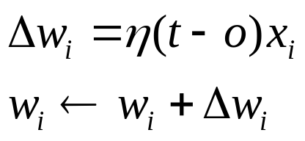
Learning in Perceptrons
Inputs: training set {(x₁,x₂,…,x_{n},t)}
Method
  Randomly initialize weights w(i), -0.5<=i<=0.5
  Repeat for several epochs until convergence:
    for each example
      Calculate network output o.
      Adjust weights:
learning rate
error
Perceptron training
rule

Slide 29
Perceptrons
Perceptron training rule guaranteed to succeed if
  Training examples are linearly separable
  Sufficiently small learning rate

Slide 30
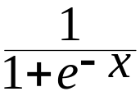
Multi-layer, feed-forward networks
Perceptrons are rather weak as computing models since they can only learn linearly-separable functions.
Thus, we now focus on multi-layer, feed forward networks of non- linear sigmoid units: i.e.,
g(x) =

Slide 31
Multi-layer feed-forward networks
Multi-layer, feed forward networks extend perceptrons i.e., 1-layer
networks into n-layer by:
Partition units into layers 0 to L such that;
lowermost layer number, layer 0 indicates the input units
topmost layer numbered L contains the output units.
layers numbered 1 to L are the hidden layers
Connectivity means bottom-up connections only, with no cycles,
hence the name"feed-forward" nets
Input layers transmit input values to hidden layer nodes hence do not
perform any computation.
Note: layer number indicates the distance of a node from the input
nodes

Slide 32
Multilayer feed forward network
o₁
o₂
output units
v₁
v₂
v₃
Hidden layer
input units
x₀ x₁ x₂ x₃ x₄

Slide 33
Hidden Units
Hidden units are nodes that are situated between the input nodes and the output nodes.
Given too many hidden units, a neural net will simply memorize the input patterns.
Given too few hidden units, the network may not be able to represent all the necessary representations.

Slide 34
Multi-layer feed-forward networks
Multi-layer feed-forward networks can be trained by back-propagation provided the activation function g is a differentiable function.
  Threshold units don’t qualify, but the sigmoid function does.
Back-propagation learning is a gradient descent search through the parameter space to minimize the sum-of-squares error.
  Most common algorithm for learning algorithms in multilayer networks

Slide 35
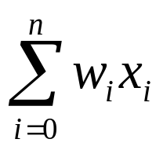

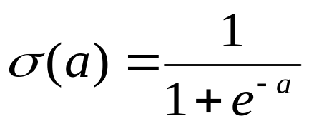
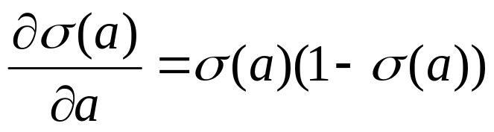
Sigmoid units
x₀
w₀
Sigmoid unit for g
o
x_{n}
w_{n}
This is g’ (the basis for gradient descent)

Slide 36
Back-propagation Learning
Inputs:
  Network topology: includes all units & their connections
  Some termination criteria
  Learning Rate (constant of proportionality of gradient descent search)
  Initial parameter values
  A set of classified training data
Output: Updated parameter values

Slide 37
Learning in backprop
Learning in backprop is similar to learning with perceptrons, i.e.,
  Example inputs are fed to the network.
    If the network computes an output vector that matches the target, nothing is done.
    If there is a difference between output and target (i.e., an error), then the weights are adjusted to reduce this error.
    The key is to assess the blame for the error and divide it among the contributing weights.
The error term (T - o) is known for the units in the output layer. To adjust the weights between the hidden and the output layer, the gradient descent rule can be applied as done for perceptrons.
To adjust weights between the input and hidden layer some way of estimating the errors made by the hidden units in needed.

Slide 38
Learning in Back-propagation
1.Initialize the weights in the network (often randomly)
2.repeat
for each example e in the training set do
i.O = neural-net-output(network, e) ; forward pass
ii.T = teacher output for e
iii.Calculate error (T - O) at the output units
iv.Compute wj = wj +α * Err * Ij for all weights from
hidden layer to output layer;backward pass
v.Compute wj = wj +α * Err * Ij for all weights from input layer
to hidden layer; backward pass continued
vi.Update the weights in the network
end
3.until all examples classified correctly or stopping criterion met
4.return(network)

Slide 39
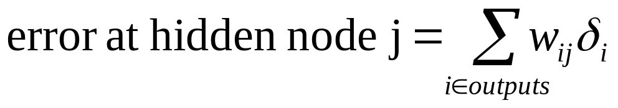

Estimating Error (see separate example)
Main idea: each hidden node contributes for some fraction of the error in each of the output nodes.
  This fraction equals the strength of the connection (weight) between the hidden node and the output node.
where is the error at output node i.

Slide 40

Number of training pairs needed?
Difficult question. Depends on the problem, the training examples, and
network architecture. However, a good rule of thumb is:
Where W = No. of weights; P = No. of training pairs, e = error rate
For example, for e = 0.1, a net with 80 weights will require 800
training patterns to be assured of getting 90% of the test patterns
correct (assuming it got 95% of the training examples correct).

Slide 41
How long should a net be trained?
The objective is to establish a balance between correct responses for the training patterns and correct responses for new patterns. (a balance between memorization and generalization).
If you train the net for too long, then you run the risk of overfitting.
In general, the network is trained until it reaches an acceptable error rate (e.g., 95%)

Slide 42
Implementing Backprop – Design Decisions
Choice of r
Network architecture
  a) How many Hidden layers? how many hidden units per a layer?
  b) How should the units be connected? (e.g., Fully, Partial, using
domain knowledge
3. Stopping criterion – when should training stop?

Slide 43
Backpropagation
Performs gradient descent over entire network weight vector
Easily generalized to arbitrary directed graphs
Will find a local, not necessarily global error minimum
  In practice, often works well (can run multiple times)
Minimizes error over training examples
  Will it generalize well to subsequent examples
    Guarding against overfitting needed
Training can take thousands of iterations (epocs) Slow!
Using network after training is very fast

Slide 44
Convergence of Backpropagation
Gradient descent to some local minimum
Perhaps not global minimum…
Add momentum
Stochastic gradient descent
Train Multiple Nets with different initial weights

Slide 45
Back-propagation Using Gradient Descent
Advantages
  Relatively simple implementation
  Standard method and generally works well
Disadvantages
  Slow and inefficient
  Can get stuck in local minima resulting in sub-optimal solutions

Slide 46
Learning rate
Ideally, each weight should have its own learning rate (extra notes on tricks for BP)
As a substitute, each neuron or each layer could have its own rate

Slide 47
Determining optimal network structure
Weak point of fixed structure networks: poor choice can lead to
poor performance
Too small network: model incapable of representing the desired
Function
Too big a network: will be able to memorize all examples but
forming a large lookup table, but will not generalize well to inputs
that have not been seen before.
Thus finding a good network structure is another example of a
search problems.
Some approaches to search for a solution for this problem include
Genetic algorithms
But using GAs can be very cpu-intensive.

Slide 48
Search: hardest task is to obtain a suitable representation
for search space in terms of nodes and weights in a network
e.g if a NN is to be used for game playing,
Inputs: describe the current state of the board game
desired output pattern: identifies the best possible
move to be made.
weights in the network can be trained based on an evaluation of
the quality of previous moves made by the network in response
to various input patterns

Slide 49
Setting the parameter values
How are the weights initialized?
Do weights change after the presentation of each pattern or only after all patterns of the training set have been presented?
How is the value of the learning rate chosen?
When should training stop?
How many hidden layers and how many nodes in each hidden layer should be chosen to build a feedforward network for a given problem?
How many patterns should there be in a training set?
How does one know that the network has learnt something useful?
COSC4P76 B.Ombuki-Berman

Slide 50
When should neural nets be used for learning a problem
If instances are given as attribute-value pairs.
  Pre-processing required: Continuous input values to be scaled in [0-1] range, and discrete values need to converted to Boolean features.
Noise in training examples.
If long training time is acceptable.

Slide 51
Neural Networks: Advantages
Distributed representations
Simple computations
Robust with respect to noisy data
Robust with respect to node failure
Empirically shown to work well for many problem domains
Parallel processing

Slide 52
Neural Networks: Disadvantages
Training is slow
Interpretability is hard
Network topology layouts ad hoc
Can be hard to debug
May converge to a local, not global, minimum of error
Not known how to model higher-level cognitive mechanisms
May be hard to describe a problem in terms of features with
numerical values

Slide 53
Applications
Classification:
  Image recognition
  Speech recognition
  Diagnostic
  Fraud detection
  Face recognition ..
Regression:
  Forecasting (prediction on base of past history)
  Forecasting e.g., predicting behavior of stock market
Pattern association:
  Retrieve an image from corrupted one
  …
Clustering:
  clients profiles
  disease subtypes
  …

Slide 54
Applications
Pronunciation: NETtalk program (Sejnowski & Rosenberg 1987) is a neural network that learns to pronounce written text: maps characters strings into phonemes (basic sound elements) for learning speech from text
Handwritten character recognition:a network designed to read zip codes on hand-addressed envelops
ALVINN (Pomerleau) is a neural network used to control vehicles steering direction so as to follow road by staying in the middle of its lane

Slide 55
Backgammon learning program
Control application: adaptive control techniques
Optimization e.g., Hopfield neural networks used to solve
the TSP

